Slide 1
XDS.b + Blockchain
Petnathean Julled

Slide 2
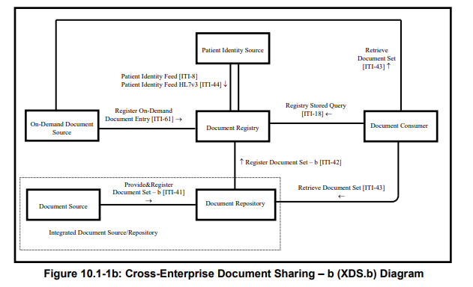
Cross-Enterprise Document Sharing – b (XDS.b)
Notes:
There should be some kind of header that specify type of transaction

Slide 3
Design Analysis
Purpose of Cross-Enterprise Document Sharing (XDS.b) Profile
The Profile facilitates the registration, distribution and access across health enterprises of patient electronic health records.
Cross-Enterprise Document Sharing is focused on providing a standards-based specification for managing the sharing of documents between any healthcare enterprise, ranging from a private physician office to a clinic to an acute care in-patient facility.
* The XDS.b Integration Profile assumes that these enterprises belong to one or more XDS Affinity Domains.
* An XDS Affinity Domain is a group of healthcare enterprises that have agreed to work together using a common set of policies and share a common infrastructure.

Slide 4
Design Analysis
Cross-Enterprise Document Sharing (XDS.b) Profile
Scope or type of sharing document is not restricted by the Profile
Security of XDS Affinity Domain depend on…
Audit Trail and Node Authentication Profile (ATNA)
Each members must have their own Audit Repository Actor
Policies of each XDS Affinity Domain
Trust between each members within XDS Affinity Domain
Confidentiality, Integrity, and Accessibility of Document Registry actor depend on members of XDS Affinity Domain
Benefit gained from Blockchain implemented
By replace traditional database of Document Registry actor with Blockchain ledger, XDS Affinity Domain then lessen required trust between each members. As none of any members can freely temper with anything existing on the Blockchain.
Blockchain ensure integrity of Document Registry. With additional mechanism of Blockchain, it also help reduce risk against confidentiality and accessibility of Document Registry.
Blockchain give additional audit system, as everything published on it cannot be modified or deleted. This is addition to ATNA.
This reduce friction for each healthcare enterprise to joint cooperation and share their data with each other which allow better patient care. <[search more about friction to joint cooperate between healthcare enterprise]

Slide 5
Design Analysis
Replacing Document Registry’s traditional database with Blockchain
Convert from centralized database to Decentralized ledger
Eliminate need of trusted 3rd party to host Document Registry
Lessen required trust between member of XDS Affinity Domain
Passively enforce agreed policies within Blockchain
Related work
EHR Blockchain: Mayo, MedRec
How to
XDS Affinity Domain need machine that have access to Ethereum Node
All Ethereum Node from each member of XDS Affinity Domain have access to the same Blockchain ledger that act as Document Registry actor
Replace related transaction that would be need to communicate with normal Document Registry with Smartcontract.
Smartcontract also need to provide additional function that give more capability to what Document Registry can do.

Slide 6
Design Analysis
Replacing Document Registry as receiver of transaction Register Document Set-b [ITI-42]
Existing
Document Repository actor send metadata of document to Document Registry actor with Register Document Set-b [ITI-42] transaction format via TCP
Requirement:
Receive XML message via TCP
Parse XML message and convert it into programming object
Response to Document Repository with message format followed ITI-42
How to
Add TCP socket message receiver function
Add XML parser function
Add constructor for ITI-42 message response following format specified in IHE XDS.b Profile
Add XML message builder function

Slide 7
Design Analysis
Convert received [ITI-42] transaction to Document Register contract and publish on Blockchain
Existing
Document Registry actor parse ITI-42 transaction and store the registry into its database
Requirement
Compatible to operate with Ethereum Blockchain
Publish Document Registry into Blockchain
Allow additional mechanism for Smartcontract
Search index function that response to registry query application
Return XML message function that response to Registry Query [ITI-18] transaction issued from Document Consumer actor
How to
Add Document Register contract publisher function which will use programming object received from [ITI-42] transaction to issue Smartcontract
Add Smartcontract function
Search index function
Return XML message function
*Both contracts will have its attributes following its parent [ITI-42] transaction

Slide 8
Design Analysis
Replacing database query with Blockchain search application as response Registry Query
Existing
Document Consumer actor seek for metadata of document by send Registry Query [ITI-18] with specified index of target document, to Document Registry
Document Registry response to the transaction and use specified index to query for target document metadata within its database
Document Registry return metadata of target document to Document Consumer actor
Requirement:
Capable to search for target document metadata using specified index (attributes) within Blockchain (Registry entry)
Publish registry query request to Blockchain as additional audit trail
How to
Document Consumer actor publish Registry Query Contract to Blockchain and send contract address to Document Registry actor
After received and verified Registry Contract from Document Consumer actor, Document Registry start search for matching document metadata
Document Registry actor will have application that take the role to accept the index and sequentially search for contract of matching document metadata
Each document metadata have Smartcontract function that ready to response to matching specified index
Search application also remember contract address of searched document metadata, to allow faster search if there are query for the same document metadata
Document Registry actor return XML message of contract with matching document metadata to Document Consumer actor
Related work
Ethereum Query Language, Blockchain transaction discovery

Slide 9
Design Analysis
Replace Document Retrieval [ITI-43] transaction with Smartcontract
Existing
After Document Consumer actor obtained information about Document Repository actor from Document Registry actor, Document Consumer actor issue Document Retrieval [ITI-43] transaction to Document Repository actor.
Document Repository actor response to the transaction and send the requested document back to Document Consumer actor.
Requirement
Following format of Document Retrieval [ITI-43] transaction
Record the action to Blockchain as additional audit trail
How to
Document Consumer publish Document Retrieval contract to Blockchain and send contract address to Document Repository actor
Document Repository actor received and verified Document Retrieval contract and response to Document Consumer actor with the requested document

